Slide 1


Slide 2

Gi-OS Flow

Slide 3
Gi-OS

Slide 4

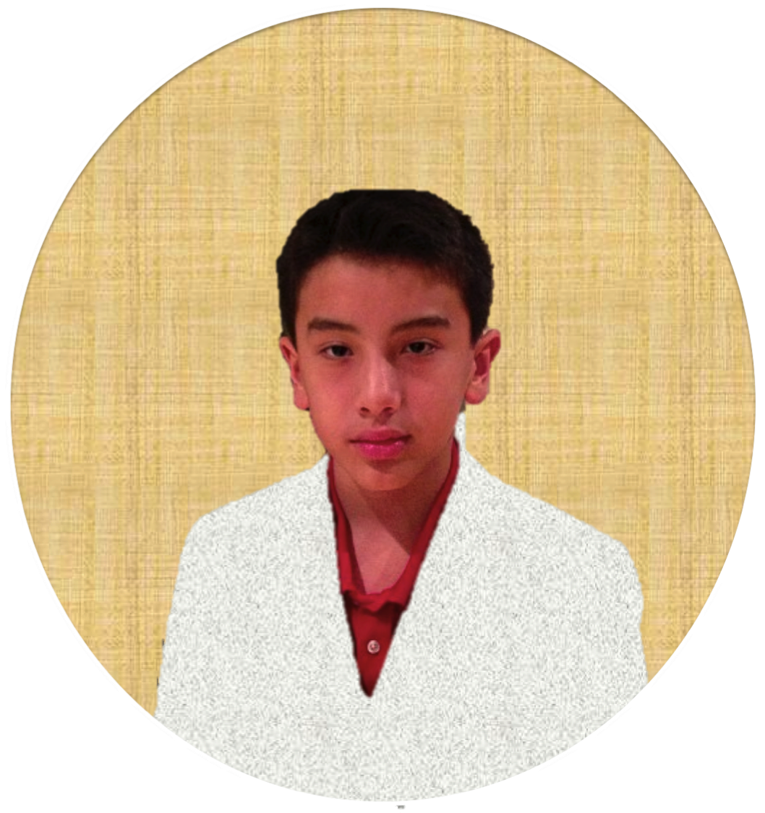
Guest
Guest
Giovanni
Admin

Slide 5

You are on the guest account, Log in to get all the features
Safari
Mail
Care.org Project
Jeffery’s Mansion
Stat Board
Sun Pinnacle
City Project
Science OS
Project

Slide 6
Guest
Guest
Giovanni
Admin

Slide 7
Zzz
External Link
External Link
Safari
Mail
Calendar
Music
Info
Today Is
4/30/14
Movie
GAMR
Projects

Slide 8
Zzz
External Link
External Link
Safari
Mail
Calendar
Music
Info
Movie
GAMR
Projects

Slide 9
Zzz
External Link
External Link
Safari
Mail
Calendar
Music
Info
Today Is
4/30/14
Movie
GAMR
Projects

Slide 10
Care.org Project
Science OS
Project
Sun Pinnacle
City Project
Jeffery’s Mansion
Stat Board

Slide 11
Zzz
External Link
External Link
Safari
Mail
Calendar
Music
Info
Movie
GAMR
Projects
MUSIC

Slide 12










MUSIC
MUSIC

Slide 13
MUSIC

Slide 14
MUSIC

Slide 15

MUSIC
E

Slide 16
MUSIC
NOW PLAYING
U CANT TOUCH THIS
MC HAMMER

Slide 17

MUSIC
NOW PLAYING
U CANT TOUCH THIS
MC HAMMER

Slide 18
MUSIC
NOW PLAYING
MR BRIGHTSIDE
THE KILLERS

Slide 19
MUSIC
NOW PLAYING
MR BRIGHTSIDE
THE KILLERS

Slide 20
MUSIC
NOW PLAYING
BOOM BOOM POW
BLACK EYE PEAS
EXPLIT

Slide 21
MUSIC
NOW PLAYING
BOOM BOOM POW
BLACK EYE PEAS
EXPLIT

Slide 22
MUSIC
NOW PLAYING
DYNAMITE
TAIO CRUZ

Slide 23
MUSIC
NOW PLAYING
DYNAMITE
TAIO CRUZ

Slide 24
MUSIC
NOW PLAYING
PARADISE
COLD PLAY

Slide 25
MUSIC
NOW PLAYING
PARADISE
COLD PLAY

Slide 26
MUSIC
NOW PLAYING
ABC
JACKSON 5

Slide 27
MUSIC
NOW PLAYING
ABC
JACKSON 5

Slide 28
MUSIC
NOW PLAYING
GET LUCKY
DAFT PUNK

Slide 29
MUSIC
NOW PLAYING
GET LUCKY
DAFT PUNK

Slide 30
MUSIC
NOW PLAYING
MOVES LIKE JAGGER
MAROON 5

Slide 31
MUSIC
NOW PLAYING
MOVES LIKE JAGGER
MAROON 5

Slide 32
MUSIC
NOW PLAYING
BAD
MICHAEL JACKSON

Slide 33
MUSIC
NOW PLAYING
BAD
MICHAEL JACKSON

Slide 34
MUSIC
NOW PLAYING
SOMETHING GOOD TO WORK ON
TWO DOOR CINEMA CLUB

Slide 35
MUSIC
NOW PLAYING
SOMETHING GOOD TO WORK ON
TWO DOOR CINEMA CLUB

Slide 36
MUSIC
NOW PLAYING
CLOUD
SCREAMN GIOS

Slide 37
MUSIC
NOW PLAYING
CLOUD
SCREAMN GIOS

Slide 38
INFO

Slide 39
INFO
Gi-OS Flow BETA 1.7 (music Update 11)
Future additions will be added in newer versions
I do not own the rights for the music
Try Out Gi-OS 1

Slide 40
CALENDAR

Slide 41
CALENDAR
2:29 PM

Slide 42
MOVIE

Slide 43
MOVIE
EVOLUTION
OS

Slide 44

MOVIE

Slide 45
MOVIE

Slide 46
Gi-OS Flow

Slide 47
Shutting Down

Slide 48
Press Esc To exit
Gi-OS Flow

